Slide 1


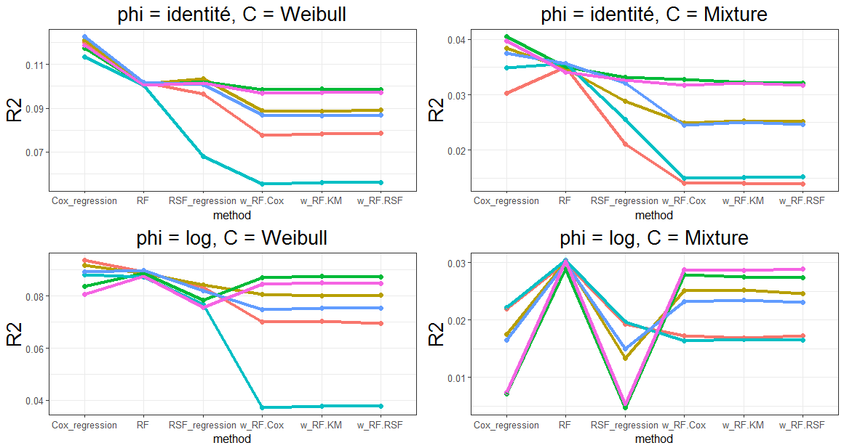
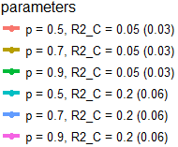
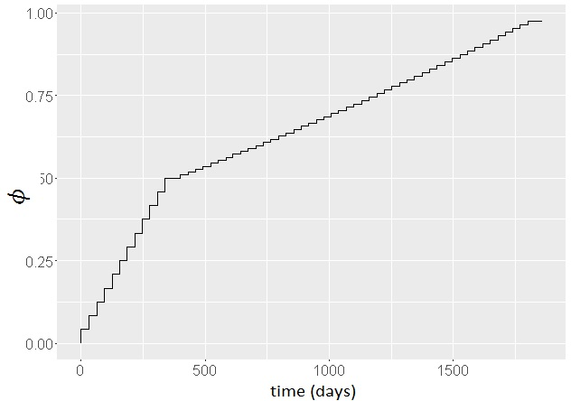
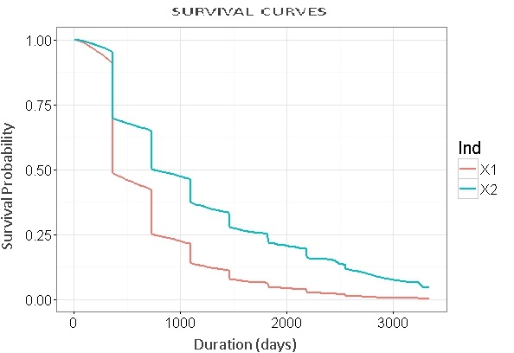
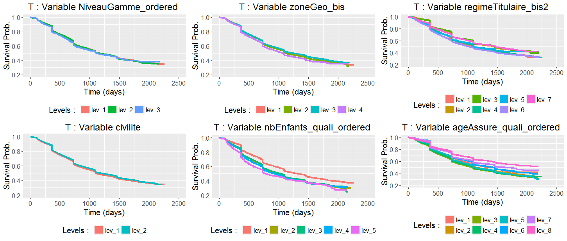
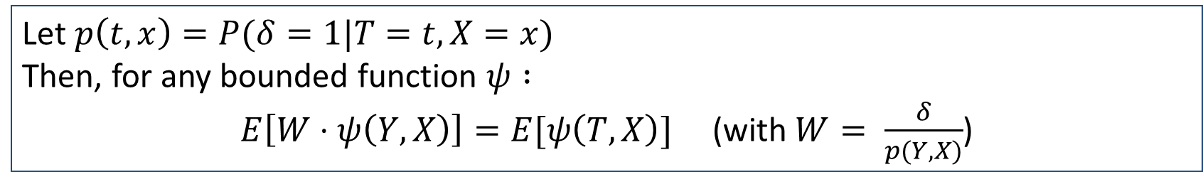
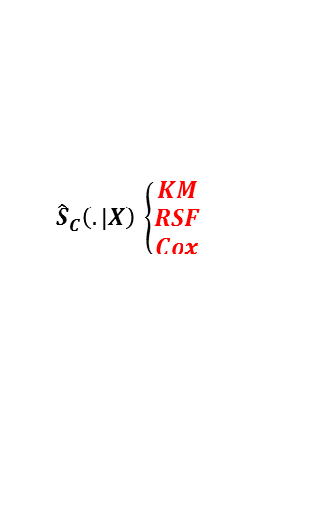

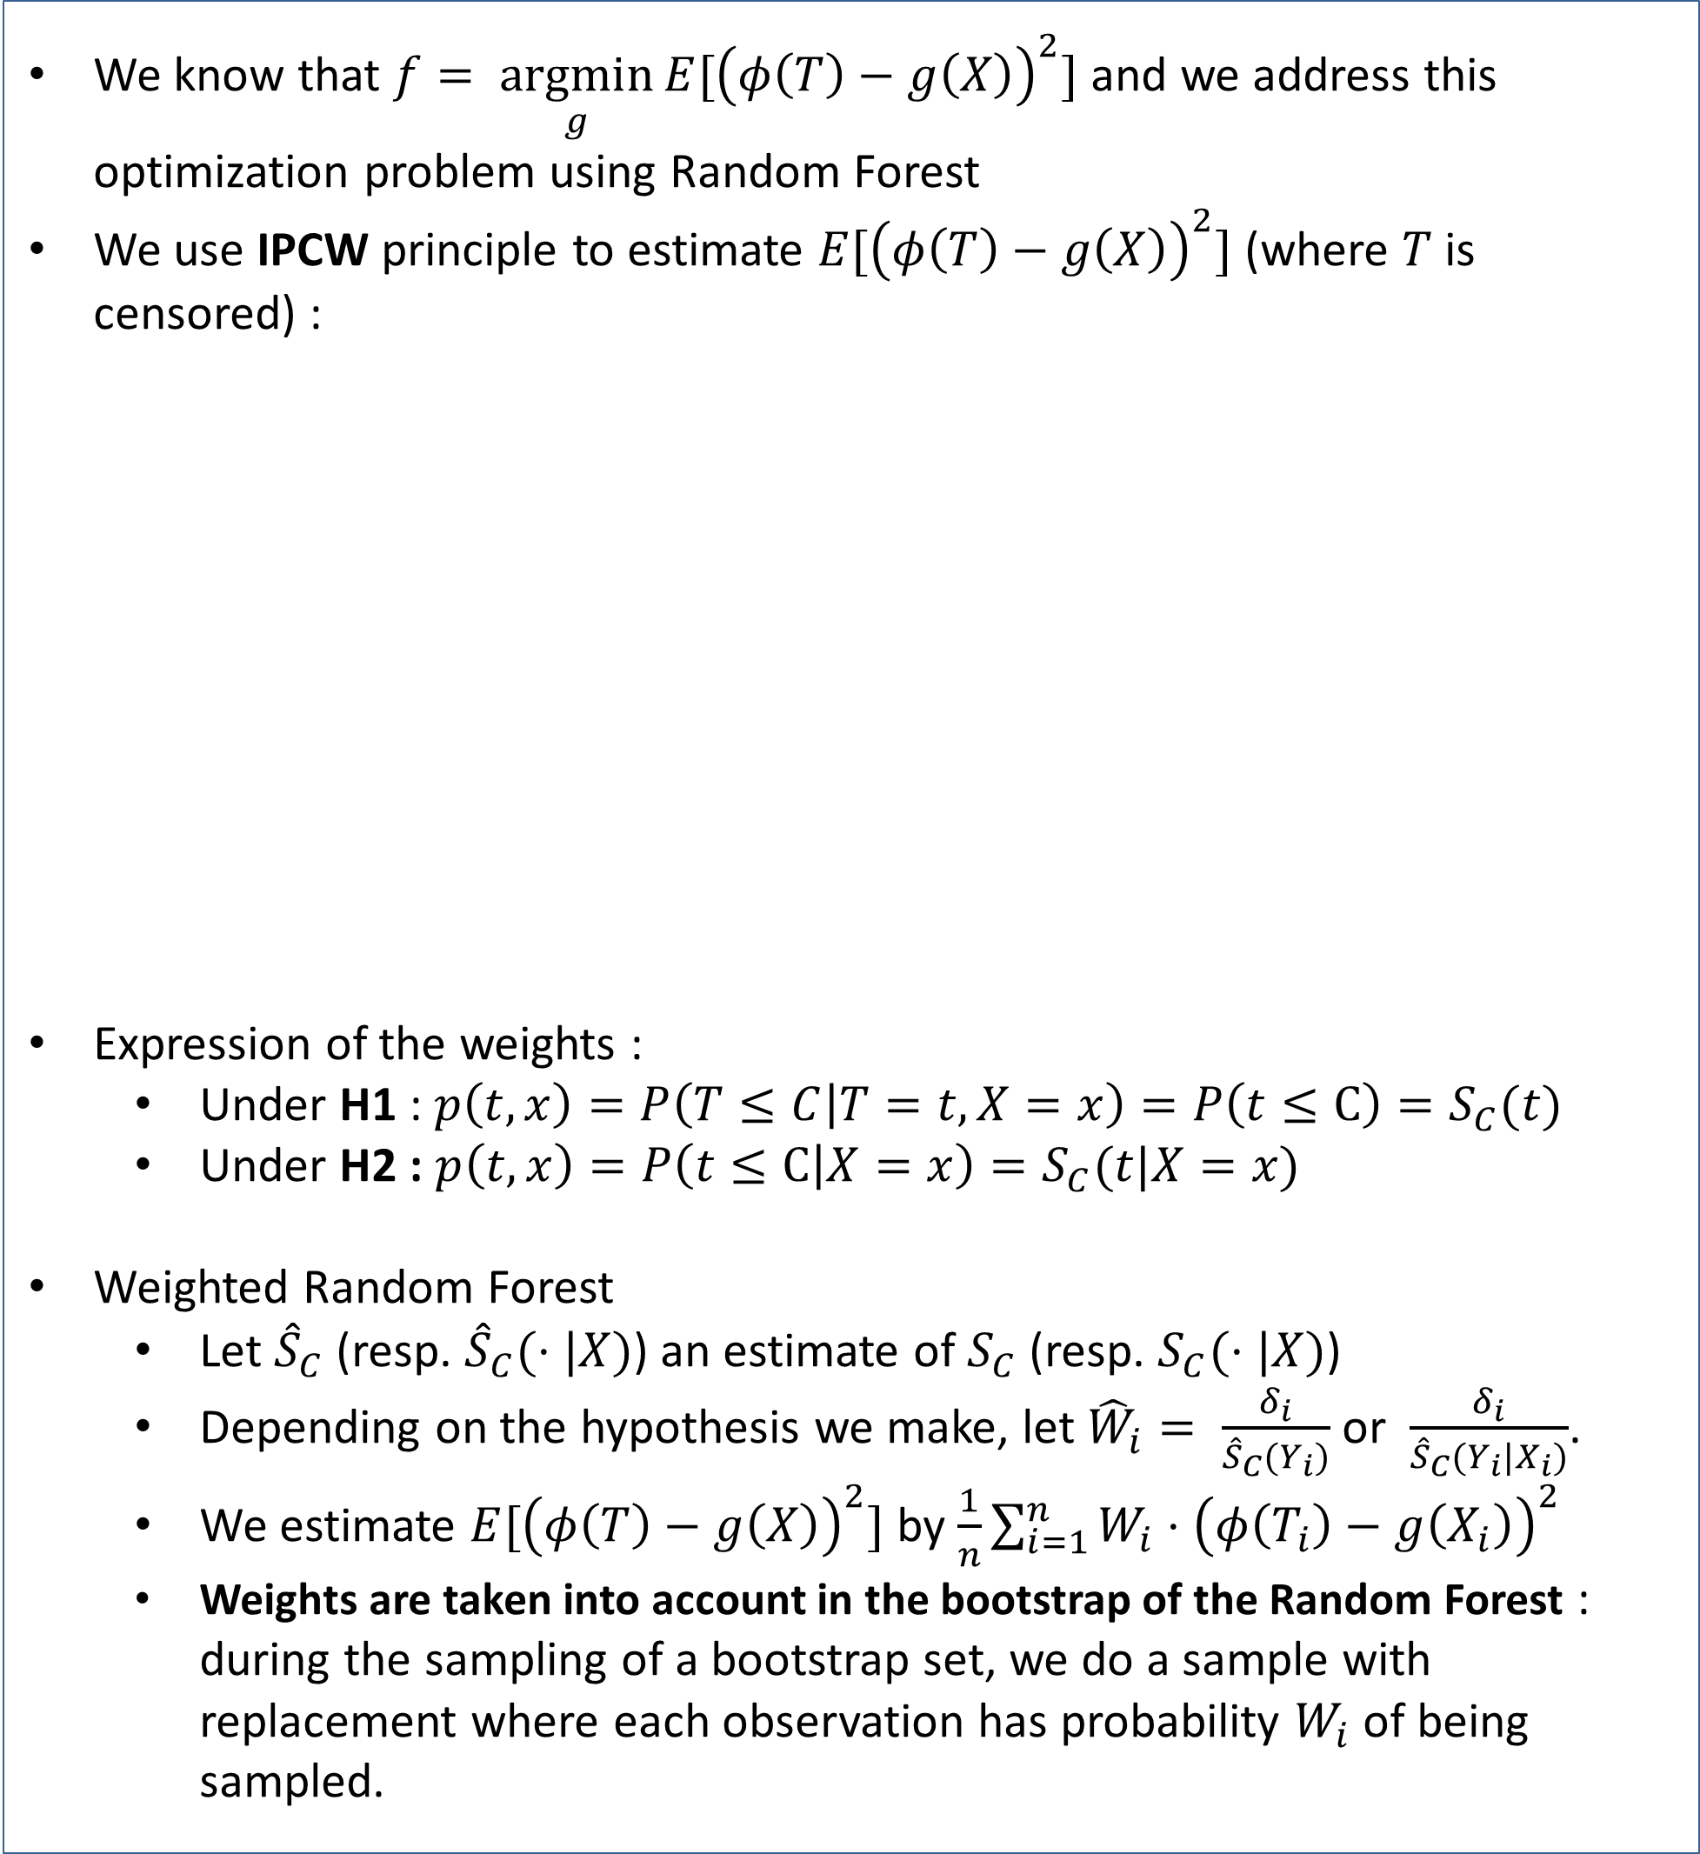
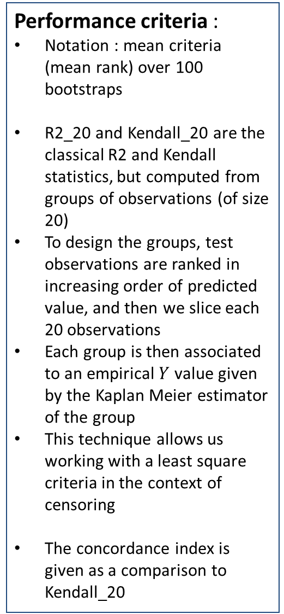

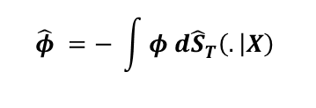
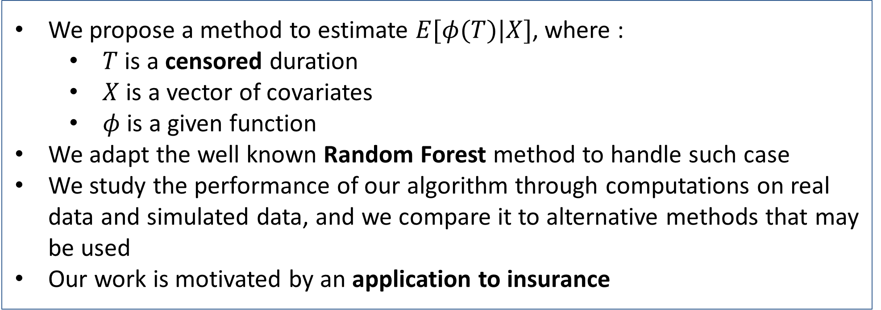
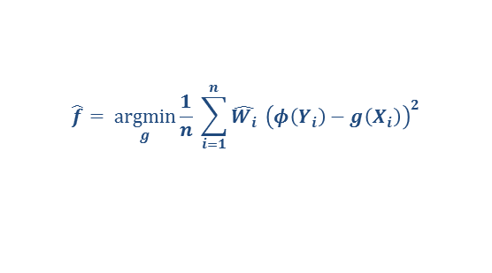
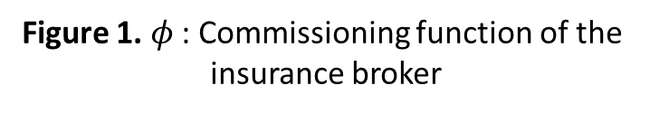
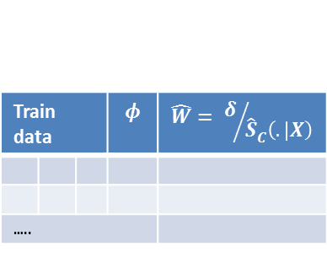
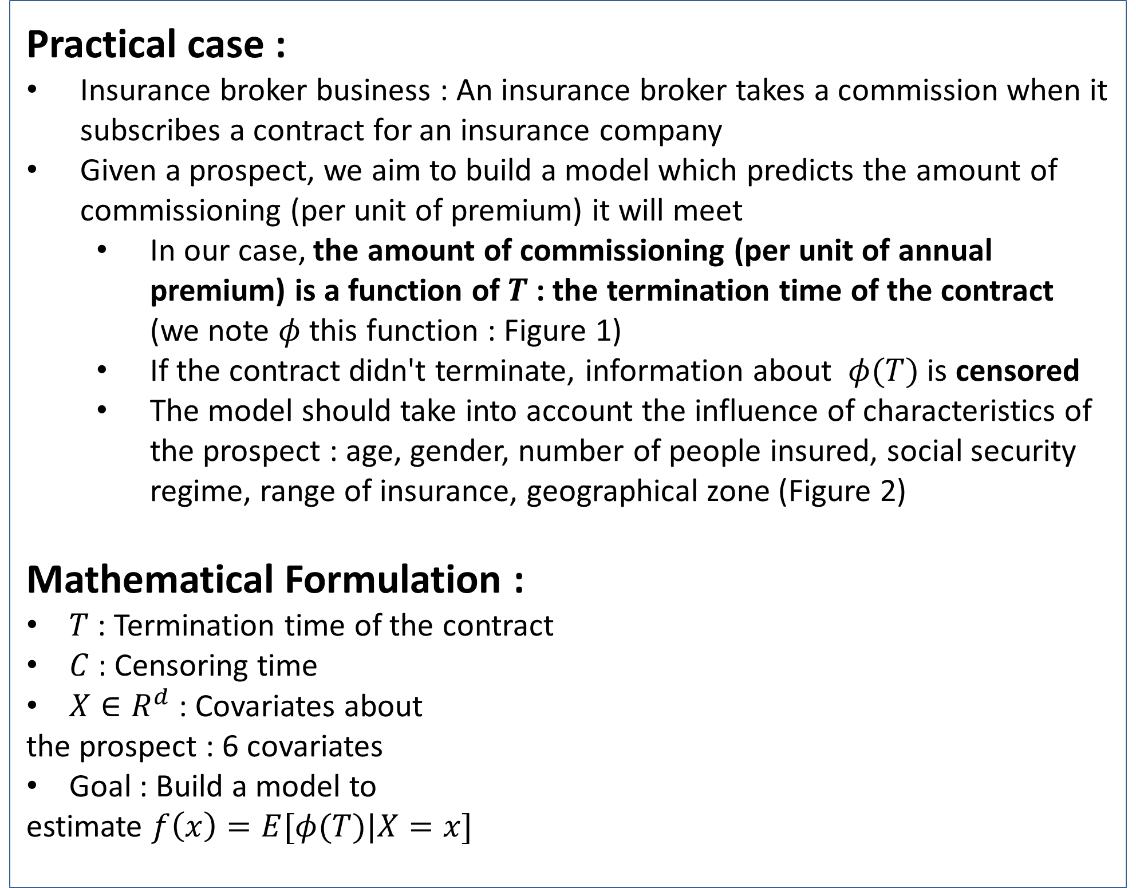

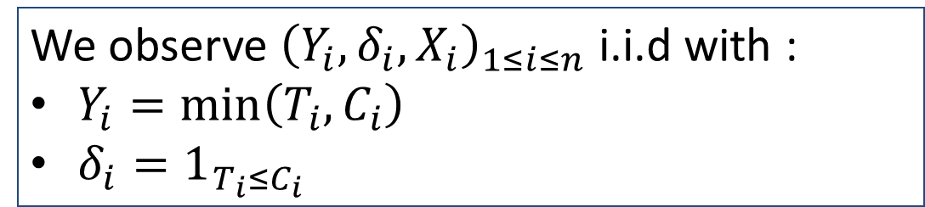
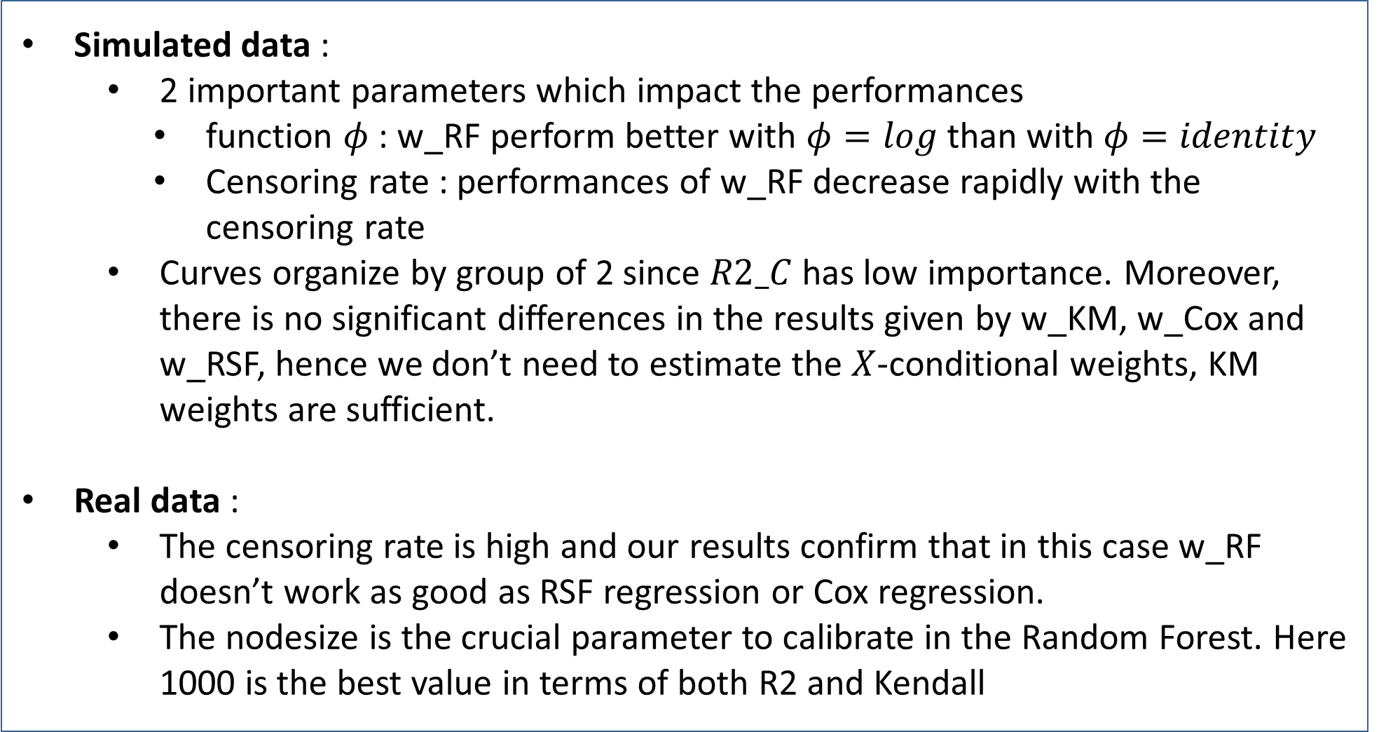

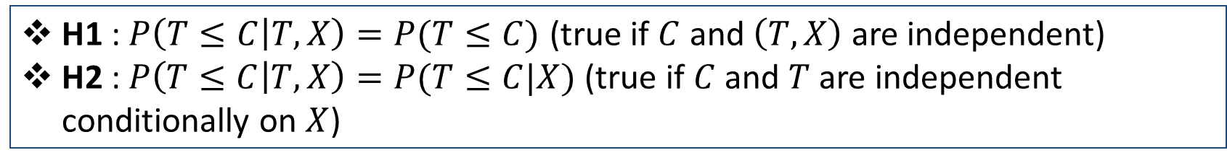
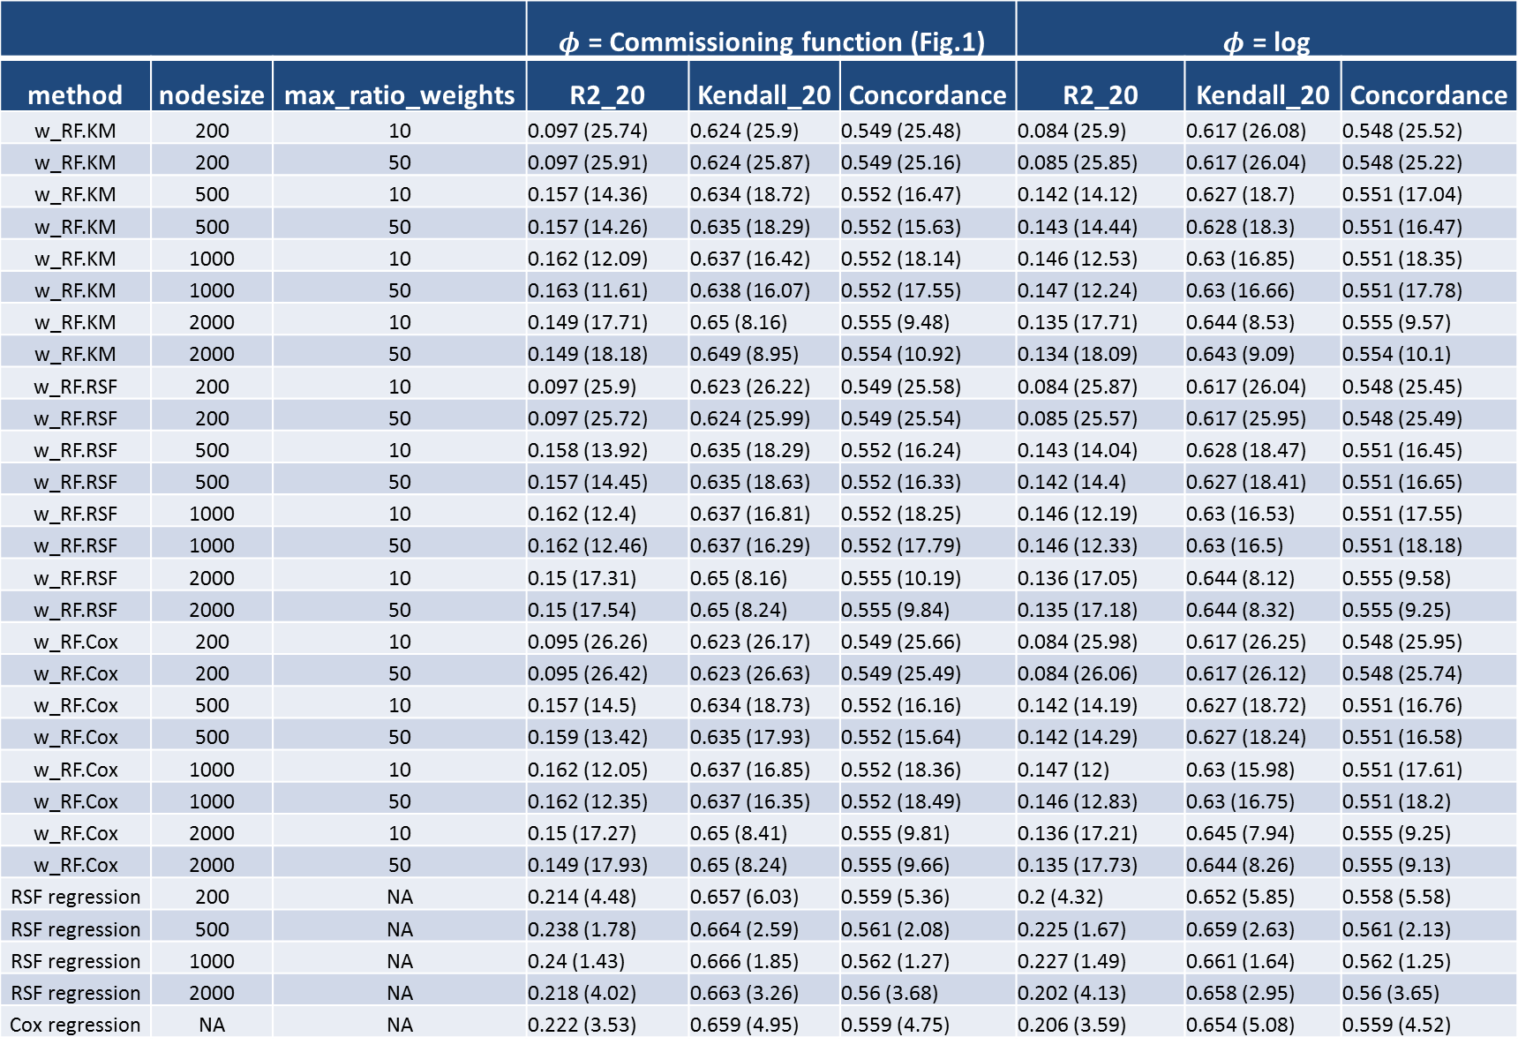
Random Forest for Regression of a Censored Variable
Yohann Le Faou (yohann.lefaou@forsides.fr)
Forsides & Sorbonne Universités - Université Pierre et Marie Curie (Paris 6, LSTA)
Contribution
Weighted Random Forest
Results
We propose a method to estimate $E[φ(T)|X]$, where :
$T$ is a censored duration
$X$ is a vector of covariates
$φ$ is a given function
We adapt the well known Random Forest method to handle such case
We study the performance of our algorithm through computations on real data and simulated data, and we compare it to alternative methods that may be used
Our work is motivated by an application to insurance
We know that $f= \underset{g}{argmin}{E[{\left(φ\left(T\right)−g\left(X\right)\right)}^{2}]}$ and we address this optimization problem using Random Forest
We use IPCW principle to estimate $E[{\left(φ\left(T\right)−g\left(X\right)\right)}^{2}]$ (where $T$ is censored) :
Expression of the weights :
Under H1 : $p\left(t,x\right)=P\left(T≤C | T=t, X=x\right)=P\left(t≤C\right)=S_{C}(t)$
Under H2 : $p\left(t,x\right)=P\left(t≤C | X=x\right)=S_{C}(t|X=x)$
Weighted Random Forest
Let ${\hat{S}}_{C}$ (resp. ${\hat{S}}_{C}(⋅|X)$) an estimate of $S_{C}$ (resp. $S_{C}(⋅|X)$)
Depending on the hypothesis we make, let ${\hat{W}}_{i}= \frac{δ_{i}}{{\hat{S}}_{C}(Y_{i})}$ or $\frac{δ_{i}}{{\hat{S}}_{C}(Y_{i}|X_{i})}$.
We estimate $E[{\left(φ\left(T\right)−g\left(X\right)\right)}^{2}]$ by $\frac{1}{n}\sum_{i=1}^{n}{W_{i}⋅{\left(φ\left(T_{i}\right)−g\left(X_{i}\right)\right)}^{2}}$
Weights are taken into account in the bootstrap of the Random Forest : during the sampling of a bootstrap set, we do a sample with replacement where each observation has probability $W_{i}$ of being sampled.
On Simulated data :
R2_C : percentage of explained variance in the model $C|X$. (values of 0.03 and 0.06
in the mixture model)
p : proportion of non-censored observation
On Real data :
IPCW principle
(Inverse Probability of Censoring Weighting)
Models :
Cox_regression : alternative method of Figure 3 (with Cox model)
RF : RF trained without censoring of the observations
RSF_regression : see Figure 3 with RSF model)
w_RF : Weighted RF approaches with given weights
In the Random Forests, we take nodesize = 100 (resp. 200) for C = Weibull (resp. Mixture)
max_ratio_weights = 20 in w_RF
Let $p\left(t,x\right)=P(δ=1|T=t,X=x)$
Then, for any bounded function $ψ :$
$E\left[W⋅ψ\left(Y,X\right)\right]=E[ψ\left(T,X\right)]$ (with $W= \frac{δ}{p(Y,X)}$)
Introduction
Hypothesis
Practical case :
Insurance broker business : An insurance broker takes a commission when it subscribes a contract for an insurance company
Given a prospect, we aim to build a model which predicts the amount of commissioning (per unit of premium) it will meet
In our case, the amount of commissioning (per unit of annual premium) is a function of $T$ : the termination time of the contract (we note $φ$ this function : Figure 1)
If the contract didn't terminate, information about $φ(T)$ is censored
The model should take into account the influence of characteristics of the prospect : age, gender, number of people insured, social security regime, range of insurance, geographical zone (Figure 2)
Mathematical Formulation :
$T$ : Termination time of the contract
$C$ : Censoring time
$X∈R^{d}$ : Covariates about
the prospect : 6 covariates
Goal : Build a model to
estimate $f\left(x\right)=E[φ(T)|X=x]$
H1 : $P\left(T≤C | T,X\right)=P(T≤C)$ (true if $C$ and $\left(T,X\right)$ are independent)
H2 :$P\left(T≤C | T,X\right)=P(T≤C|X)$ (true if $C$ and $T$are independent conditionally on $X$)
Performance criteria :
Notation : mean criteria (mean rank) over 100 bootstraps
R2_20 and Kendall_20 are the classical R2 and Kendall statistics, but computed from groups of observations (of size 20)
To design the groups, test observations are ranked in increasing order of predicted value, and then we slice each 20 observations
Each group is then associated to an empirical $Y$ value given by the Kaplan Meier estimator of the group
This technique allows us working with a least square criteria in the context of censoring
The concordance index is given as a comparison to Kendall_20
 |  |  | $φ$ = Commissioning function (Fig.1) |  |  | $φ$ = log
method | nodesize | max_ratio_weights | R2_20 | Kendall_20 | Concordance | R2_20 | Kendall_20 | Concordance
w_RF.KM | 200 | 10 | 0.097 (25.74) | 0.624 (25.9) | 0.549 (25.48) | 0.084 (25.9) | 0.617 (26.08) | 0.548 (25.52)
w_RF.KM | 200 | 50 | 0.097 (25.91) | 0.624 (25.87) | 0.549 (25.16) | 0.085 (25.85) | 0.617 (26.04) | 0.548 (25.22)
w_RF.KM | 500 | 10 | 0.157 (14.36) | 0.634 (18.72) | 0.552 (16.47) | 0.142 (14.12) | 0.627 (18.7) | 0.551 (17.04)
w_RF.KM | 500 | 50 | 0.157 (14.26) | 0.635 (18.29) | 0.552 (15.63) | 0.143 (14.44) | 0.628 (18.3) | 0.551 (16.47)
w_RF.KM | 1000 | 10 | 0.162 (12.09) | 0.637 (16.42) | 0.552 (18.14) | 0.146 (12.53) | 0.63 (16.85) | 0.551 (18.35)
w_RF.KM | 1000 | 50 | 0.163 (11.61) | 0.638 (16.07) | 0.552 (17.55) | 0.147 (12.24) | 0.63 (16.66) | 0.551 (17.78)
w_RF.KM | 2000 | 10 | 0.149 (17.71) | 0.65 (8.16) | 0.555 (9.48) | 0.135 (17.71) | 0.644 (8.53) | 0.555 (9.57)
w_RF.KM | 2000 | 50 | 0.149 (18.18) | 0.649 (8.95) | 0.554 (10.92) | 0.134 (18.09) | 0.643 (9.09) | 0.554 (10.1)
w_RF.RSF | 200 | 10 | 0.097 (25.9) | 0.623 (26.22) | 0.549 (25.58) | 0.084 (25.87) | 0.617 (26.04) | 0.548 (25.45)
w_RF.RSF | 200 | 50 | 0.097 (25.72) | 0.624 (25.99) | 0.549 (25.54) | 0.085 (25.57) | 0.617 (25.95) | 0.548 (25.49)
w_RF.RSF | 500 | 10 | 0.158 (13.92) | 0.635 (18.29) | 0.552 (16.24) | 0.143 (14.04) | 0.628 (18.47) | 0.551 (16.45)
w_RF.RSF | 500 | 50 | 0.157 (14.45) | 0.635 (18.63) | 0.552 (16.33) | 0.142 (14.4) | 0.627 (18.41) | 0.551 (16.65)
w_RF.RSF | 1000 | 10 | 0.162 (12.4) | 0.637 (16.81) | 0.552 (18.25) | 0.146 (12.19) | 0.63 (16.53) | 0.551 (17.55)
w_RF.RSF | 1000 | 50 | 0.162 (12.46) | 0.637 (16.29) | 0.552 (17.79) | 0.146 (12.33) | 0.63 (16.5) | 0.551 (18.18)
w_RF.RSF | 2000 | 10 | 0.15 (17.31) | 0.65 (8.16) | 0.555 (10.19) | 0.136 (17.05) | 0.644 (8.12) | 0.555 (9.58)
w_RF.RSF | 2000 | 50 | 0.15 (17.54) | 0.65 (8.24) | 0.555 (9.84) | 0.135 (17.18) | 0.644 (8.32) | 0.555 (9.25)
w_RF.Cox | 200 | 10 | 0.095 (26.26) | 0.623 (26.17) | 0.549 (25.66) | 0.084 (25.98) | 0.617 (26.25) | 0.548 (25.95)
w_RF.Cox | 200 | 50 | 0.095 (26.42) | 0.623 (26.63) | 0.549 (25.49) | 0.084 (26.06) | 0.617 (26.12) | 0.548 (25.74)
w_RF.Cox | 500 | 10 | 0.157 (14.5) | 0.634 (18.73) | 0.552 (16.16) | 0.142 (14.19) | 0.627 (18.72) | 0.551 (16.76)
w_RF.Cox | 500 | 50 | 0.159 (13.42) | 0.635 (17.93) | 0.552 (15.64) | 0.142 (14.29) | 0.627 (18.24) | 0.551 (16.58)
w_RF.Cox | 1000 | 10 | 0.162 (12.05) | 0.637 (16.85) | 0.552 (18.36) | 0.147 (12) | 0.63 (15.98) | 0.551 (17.61)
w_RF.Cox | 1000 | 50 | 0.162 (12.35) | 0.637 (16.35) | 0.552 (18.49) | 0.146 (12.83) | 0.63 (16.75) | 0.551 (18.2)
w_RF.Cox | 2000 | 10 | 0.15 (17.27) | 0.65 (8.41) | 0.555 (9.81) | 0.136 (17.21) | 0.645 (7.94) | 0.555 (9.25)
w_RF.Cox | 2000 | 50 | 0.149 (17.93) | 0.65 (8.24) | 0.555 (9.66) | 0.135 (17.73) | 0.644 (8.26) | 0.555 (9.13)
RSF regression | 200 | NA | 0.214 (4.48) | 0.657 (6.03) | 0.559 (5.36) | 0.2 (4.32) | 0.652 (5.85) | 0.558 (5.58)
RSF regression | 500 | NA | 0.238 (1.78) | 0.664 (2.59) | 0.561 (2.08) | 0.225 (1.67) | 0.659 (2.63) | 0.561 (2.13)
RSF regression | 1000 | NA | 0.24 (1.43) | 0.666 (1.85) | 0.562 (1.27) | 0.227 (1.49) | 0.661 (1.64) | 0.562 (1.25)
RSF regression | 2000 | NA | 0.218 (4.02) | 0.663 (3.26) | 0.56 (3.68) | 0.202 (4.13) | 0.658 (2.95) | 0.56 (3.65)
Cox regression | NA | NA | 0.222 (3.53) | 0.659 (4.95) | 0.559 (4.75) | 0.206 (3.59) | 0.654 (5.08) | 0.559 (4.52)
Observations
Setting of the experiments
We observe ${\left(Y_{i},δ_{i},X_{i}\right)}_{1≤i≤n}$ i.i.d with :
$Y_{i}=\min\left(T_{i},C_{i}\right)$
$δ_{i}=1_{T_{i}≤C_{i}}$
We compare the performances of 5 models (Figure 3):
3 Weighted RF :
weights estimated under H1 : Kaplan Meier (KM)
weights estimated under H2 : Cox, or RSF (Random Survival Forest)
2 Alternative methods : “Cox regression” and “RSF regression”
Data
Simulated data
$X \sim Unif({\left[−1;1\right]}^{6})$
2 settings for the law of $T$ and $C$:
Setting 1 : Weibull - $T|X \sim Weibull(λ_{1}. e^{−{}_{}^{t}{β_{1}. X}}, k_{1})$, $C|X \sim Weibull(λ_{2}. e^{−{}_{}^{t}{β_{2}. X}}, k_{2})$
Setting 2 : Mixture of Weibull - $T|X,G \sim Weibull(λ_{1}. e^{−{}_{}^{t}{β_{1,G}. X}}, k_{1})$ ,
$C|X,G \sim Weibull(λ_{2}. e^{−{}_{}^{t}{β_{2,G}. X}}, k_{2})$ with $G \sim unif(\left\{1,2,3,4\right\})$
Real data
Data from a health insurance broker $≈$ 70 000 observations
47,8% is non censored
6 qualitative covariates with some of them ordered (like age brackets) : age, gender, number of people insured, social security regime, range of insurance, geographical zone
Methodologies :
Simulated data : train = 1000, test = 1000 (we can compute exact criteria)
Real data : train = 10000, test = 50000 (we can‘t compute exact criteria)
Means and standard deviations of the studied models are calculated using 100 bootstrap samples of data
Practical issues :
In practice we replace $T$ by $min⁡(T,const)$ so that we can calculate quantities like ${\int{φ d\hat{S}}}_{T}$
We threshold the weights (in the w_RF method) so that the ratio between the smallest and the biggest weight doesn’t exceed “max ratio weights”
Weighted RF
$${\hat{S}}_{C}^{}\left(. | X\right) \left\{\begin{aligned}KM \\ RSF \\ Cox\end{aligned}\right.$$
$\hat{φ} = \hat{f}(x)$ : prediction of the random forest
Analysis of results
Train data |  |  | $$φ$$ | $$\hat{W}= δ/{{\hat{S}}_{C}^{}\left(. | X\right)}$$
…..
$$\hat{f}= \underset{g}{argmin}{\frac{1}{n}} \sum_{i=1}^{n}{\hat{W_{i}}} {\left(φ\left(Y_{i}\right)−g\left(X_{i}\right)\right)}^{2}$$
Simulated data :
2 important parameters which impact the performances
function $φ$ : w_RF perform better with $φ=log$ than with $φ=identity$
Censoring rate : performances of w_RF decrease rapidly with the censoring rate
Curves organize by group of 2 since $R2_C$ has low importance. Moreover, there is no significant differences in the results given by w_KM, w_Cox and w_RSF, hence we don’t need to estimate the $X$-conditional weights, KM weights are sufficient.
Real data :
The censoring rate is high and our results confirm that in this case w_RF doesn’t work as good as RSF regression or Cox regression.
The nodesize is the crucial parameter to calibrate in the Random Forest. Here 1000 is the best value in terms of both R2 and Kendall
Alternative methods
${\hat{S}}_{T}^{}\left(. | X\right)$ : Cox, RSF
$$\hat{φ} =− \int{φ d{\hat{S}}_{T}^{}\left(. | X\right)}$$
Train data
…..
References
Figure 1. $φ$ : Commissioning function of the
insurance broker
Figure 3. Different compared models
Conclusion
We show through a quantitative study that the weighted Random Forest method is competitive compared to other algorithm, and achieves the best performances in some settings
We provide a least square criteria to do model selection in the context of right censoring
Soon : a R package and an article
Figure 2. Descriptive statistics (data was blurred for confidentiality)

